Slide 1

Silver Oak College of Computer Application
Department of Computer Application
A PROJECT PRESENTATION
ON
JOB PORTAL
Submitted By
Kapil Dave(2304070100022)
Master of Computer Application
Semester III
Guide
Mr. Shubh Shah
Submitted To
Department of Computer Application
Silver Oak University, Gota, Ahmedabad, 382481
Academic Year 2026-27

Slide 2
1. PROJECT PROFILE
Project Profile: | JOB PORTAL
Objective: | The objective of the Job Portal Project is to develop a comprehensive, user-friendly, and scalable online platform that connects job seekers with employers by facilitating efficient job posting, application management, and candidate selection processes. The portal aims to enhance the hiring experience by offering advanced search capabilities, personalized recommendations, automated resume screening, and seamless communication between applicants and recruiters. Additionally, it strives to provide analytical tools for employers to track recruitment metrics and improve their hiring strategies.
Platform of Application: | Web base Application
Front End Tool: | PHP 8.0.12
Back End Tool: | MySQL 5.6.17
Project Duration : | 3 Months
Project Guide :
Submitted By : | Kapil Dave :2304070100022
Submitted To : | Department Of Computer Applicatiion

Slide 3
2. EXISTING SYSTEM
The existing system for job recruitment predominantly comprises traditional methods and outdated online platforms that lack the sophistication required for modern hiring needs. Many existing systems include:
Employers manually post job advertisements in newspapers, notice boards, or basic online bulletin boards..
Search functionalities are often limited, with inadequate filtering options, resulting in a poor user experience for both recruiters and applicants.
Communication between recruiters and candidates is often fragmented and lacks centralized messaging features.
Employers face difficulty in tracking the recruitment process effectively

Slide 4
3. NEED FOR NEW SYSTEM
Large numbers of auctioneer and bidders through digital platform.
Auctioneer and bidder participate from globally.
Time and money saving system.
Website | UI & UX | Easy Navigation | Any Charges | Secure
gsaauctions.gov
webstore.com
atomicmall.com
sothebys.com
Bidder’s Point

Slide 5
FUNCTIONAL SPECIFICATION
4.1 USER OF THE SYSTEM
(1) Admin:-
    User Management
    Job Management.
    Reports & Analytics
    Content Management
    Security Management
    Feedback & Support Management
    Notification Management
    System Settings & Configuration

Slide 6
4. FUNCTIONAL SPECIFICATION
4.1 USER OF THE SYSTEM
(2) Company Register :-
    The Company can Manage Register form verification
    After submitting the registration form, a verification link is sent to the provided email address to confirm its validity.
    Admins can review company profiles before granting access to ensure legitimacy.
    Once verified and approved, companies can log in using their registered email and password.
    After successful login, companies can access the employer dashboard to post jobs, view applications, and manage their profile.

Slide 7
4. FUNCTIONAL SPECIFICATION
4.1 USER OF THE SYSTEM
3) Workflow:-
Company fills out the registration form and submits.
System sends an email verification link to the registered email.
Company clicks the link to verify their email.
(Optional) Admin reviews and approves the registration.
Company logs in and accesses employer dashboard.

Slide 8
5. SYSTEM REQUIREMENT
5.1 MINIMUM SOFTWARE REQUIREMENT
Server Side Requirement
Operating System | Window Server 2003 or Any Compatible Server OS
Web Server | APACHE
Front-End Tools | PHP 8.0.12
Back-End Tool | MySQL 5.6.17
Client Side Requirement
Operating System | Window XP or Any Compatible OS
Web Browser | Google Chrome or Any Compatible Browser

Slide 9
5. SYSTEM REQUIREMENT
5.2 MINIMUM HARDWARE REQUIREMENT
Server Side Requirement
Processor | 2.8 GHz
RAM | 2 GB
Hard disk | 4 GB(Free Space)
Client Side Requirement
Processor | 1.33 GHz
RAM | 2 GB
Hard disk | 4 GB(Free Space)

Slide 10
6. SYSTEM FLOWCHART

Slide 11
7. ER DIAGRAM

Slide 12
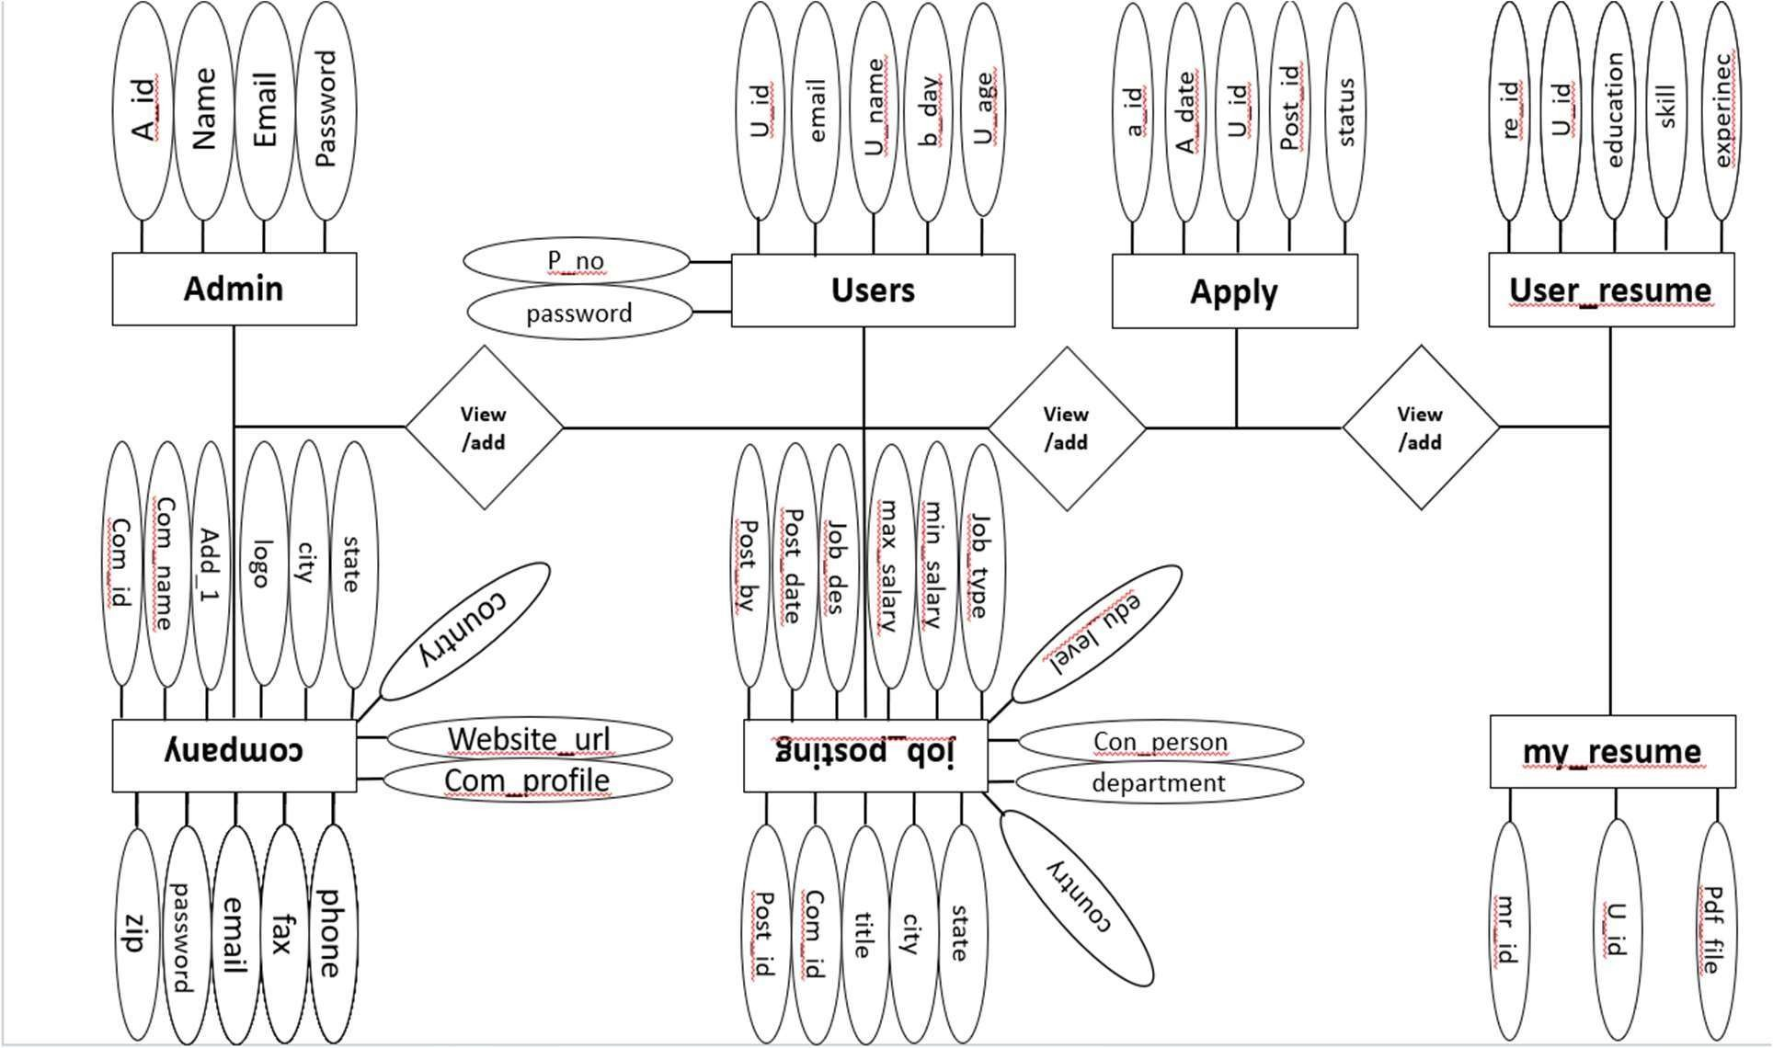

Slide 13
8. DATAFLOW DIAGRAM

Slide 14
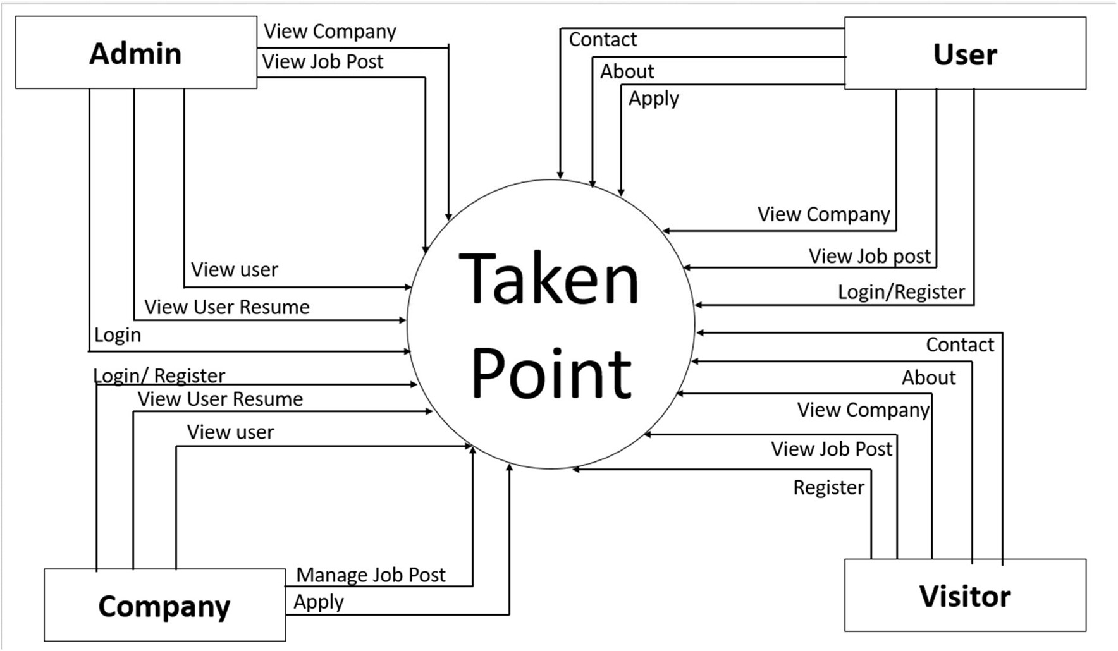
8. DATAFLOW DIAGRAM

Slide 15
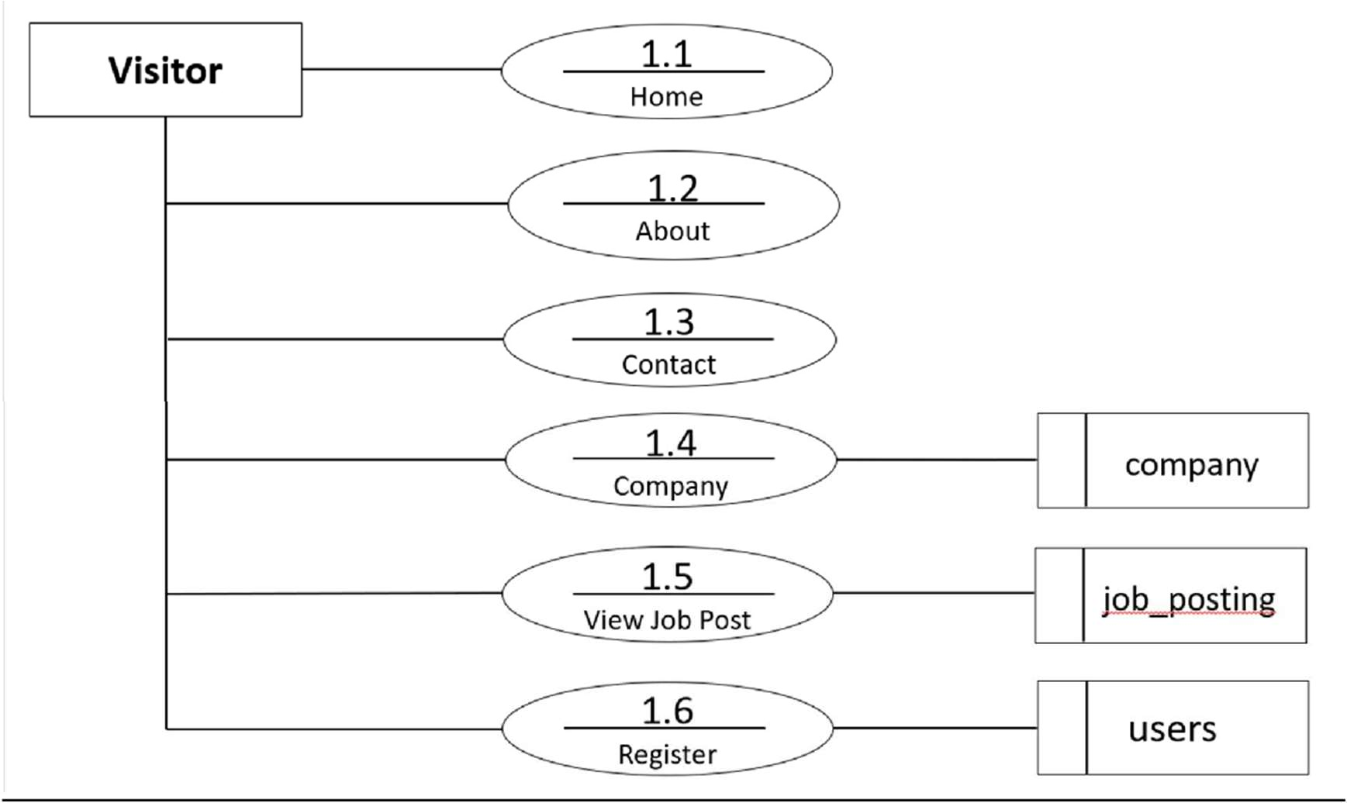
8.2 FIRST LEVEL DFD

Slide 16
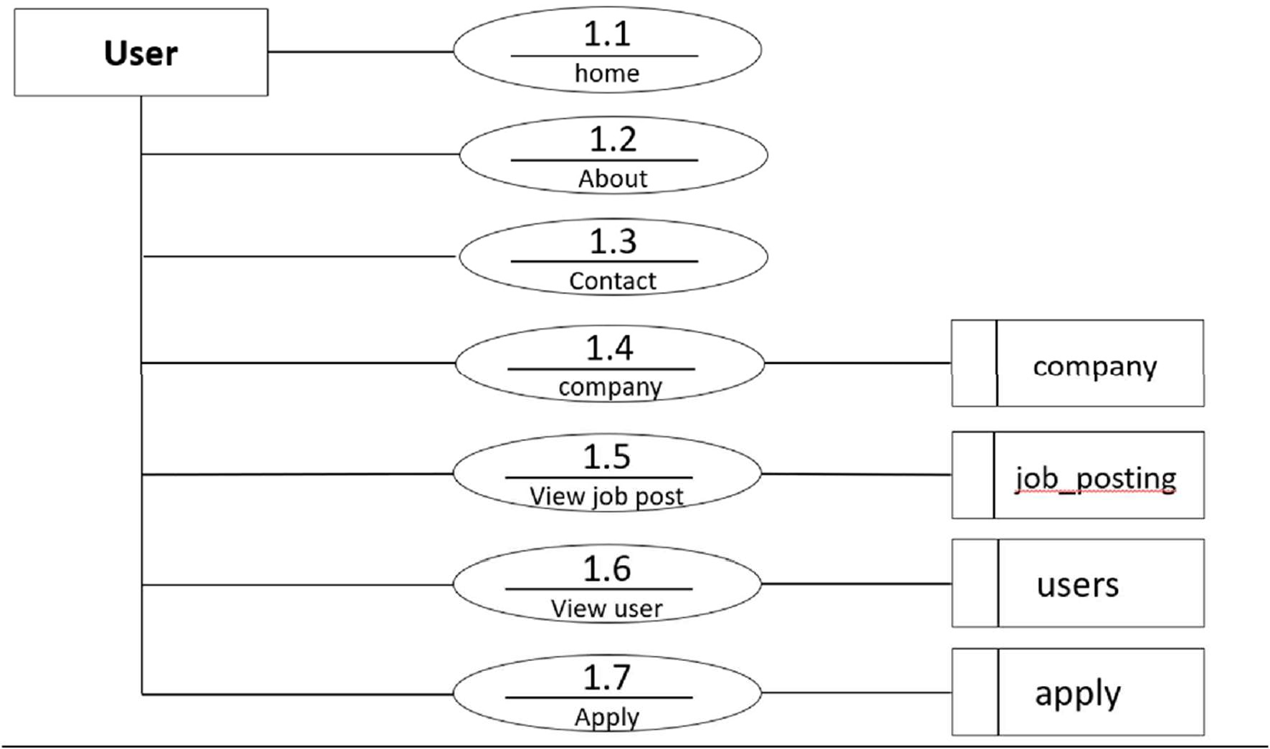
DATA FLOW CHART(User)

Slide 17
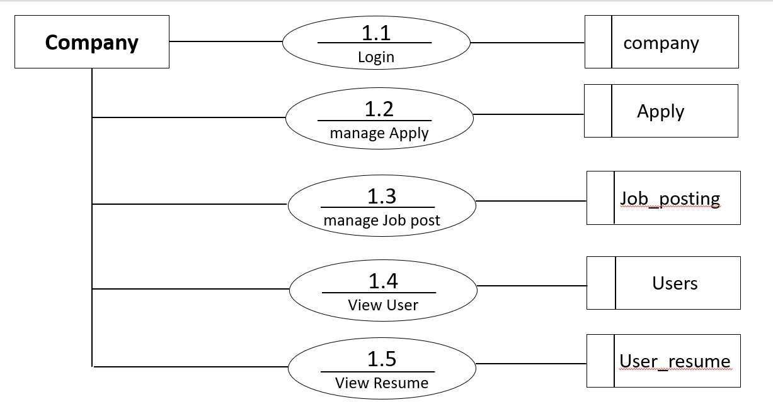
DATA FLOW CHART (Company)

Slide 18

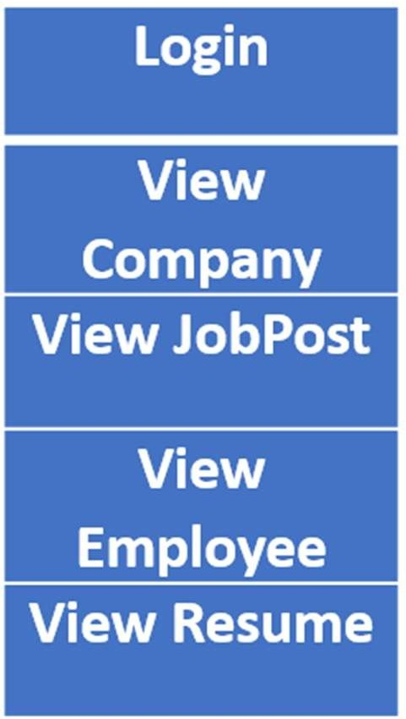

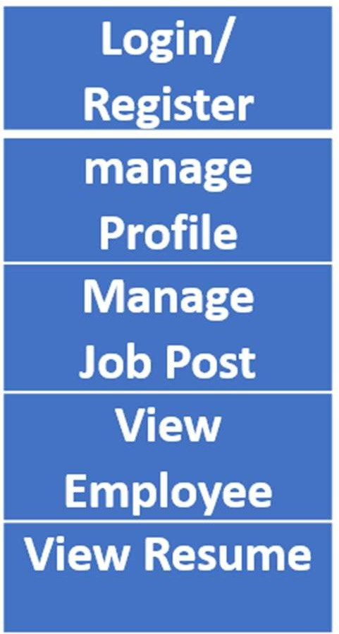
Use case Diagram
User case Diagram (Admin)
User case Diagram (Company)

Slide 19


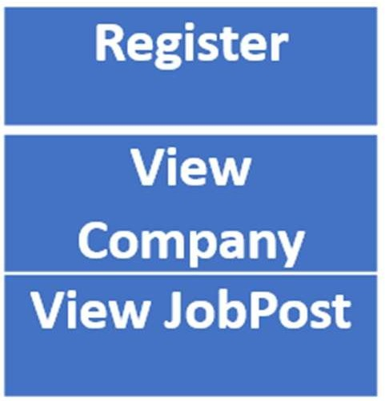
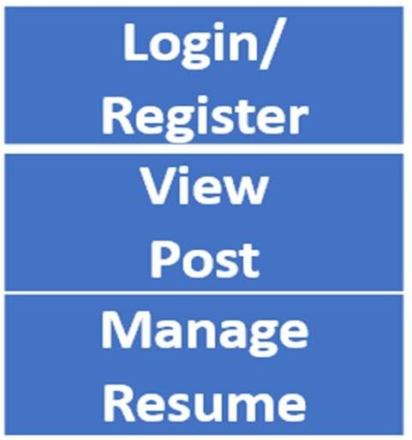
Use case Diagram
User case Diagram (User)
User case Diagram (Visitor)

Slide 20
9. DATA DICTIONARY
TABLE NAME
Admin
Apply
My resume
User resume
Company
Job Posting
User

Slide 21
Users
Admin:
My resume:
Field Name | Data Types | Size | Constraints
a_id | Int | 5 | Primary key
a_name | Varchar | 10 | Not null
email | Varchar | 20 | Not null
Password | Varchar | 10 | Not null
Field Name | Data Types | Size | Constraints
mr_id | Int | 5 | Primary key
u_id | Varchar | 50 | Not null
pdf_file | Varchar | 50 | Not null
Apply:
Field Name | Data Types | Size | Constraints
ap_id | Int | 5 | Primary key
ap_date | Date | 10 | Not null
u_id | Varchar | 10 | Not null
posting_id | Varchar | 10 | Not null
status | Varchar | 50 | Not null

Slide 22
User Resume
Job Posting:
Field Name | Data Types | Size | Constraints
re_id | Int | 5 | Primary key
u_id | Int | 5 | Primary key
education | Varchar | 50 | Not null
skill | Varchar | 10 | Not null
Experience | Varchar | 5 | Not null
Field Name | Data Types | Size | Constraints
post_id | Int | 5 | Primary key
com_id | Int | 50 | Reference Key
con_person | Varchar | 50 | Not null
title | Varchar | 20 | Not null
department | Varchar | 20 | Not null
city | Varchar | 20 | Not null
State | Varchar | 20 | Not null
country | Varchar | 20 | Not null
edu_level | Varchar | 30 | Not null
job_type | Varchar | 20 | Not null
min_salary | Int | 10 | Not null
max_salary | Int | 10 | Not null
job_des | Varchar | 20 | Not null
post_date | Date | 10 | Not null
post_by | Varchar | 20 | Not null
company:
Field Name | Data Types | Size | Constraints
com_id | Int | 5 | Primary key
com_name | Varchar | 50 | Not null
add_1 | Varchar | 50 | Not null
logo | Image | 100 | Not null
city | Varchar | 20 | Not null
state | Varchar | 20 | Not null
company | Varchar | 30 | Not null
zip | Int | 20 | Not null
phone | Int | 20 | Not null
fax | Int | 20 | Not null
email | Varchar | 20 | Not null
website_url | Varchar | 20 | Not null
com_profile | Varchar | 20 | Not null
Password | Varchar | 20 | Not null
user:
Field Name | Data Types | Size | Constraints
u_id | Int | 5 | Not null
Email | Varchar | 50 | Not null
u_name | Varchar | 50 | Not null
b_date | Date | 20 | Not null
u_age | Int | 20 | Not null
p_no | Int | 10 | Not null
Password | Varchar | 20 | Not null
Profile | Varchar | 30 | Not null

Slide 23
10. SCREENSHOT

Slide 24
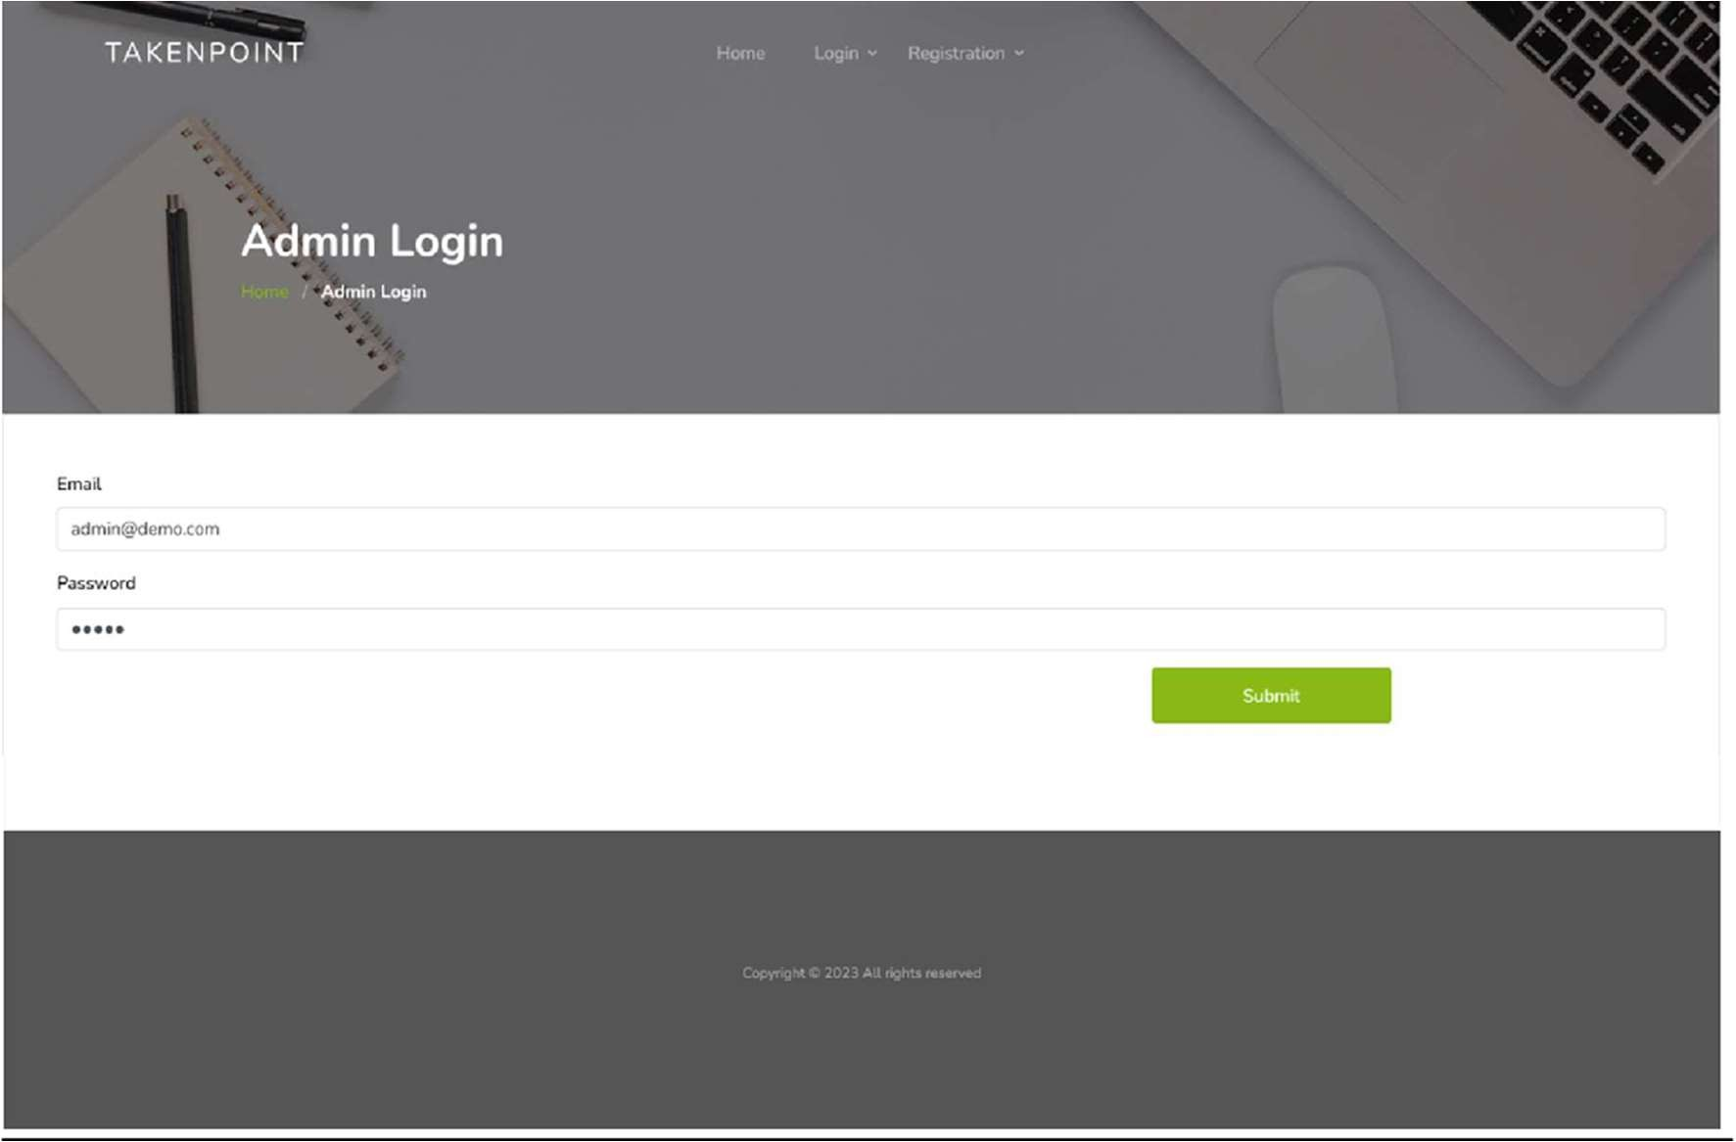
Login page
This is login page of admin
in this page admin can login and open admin page. If username and password are invalid He\she can see message username and password are invalid”.

Slide 25

Admin Home:
This is Admin Home Page.
Here the welcome message appears after admin login

Slide 26
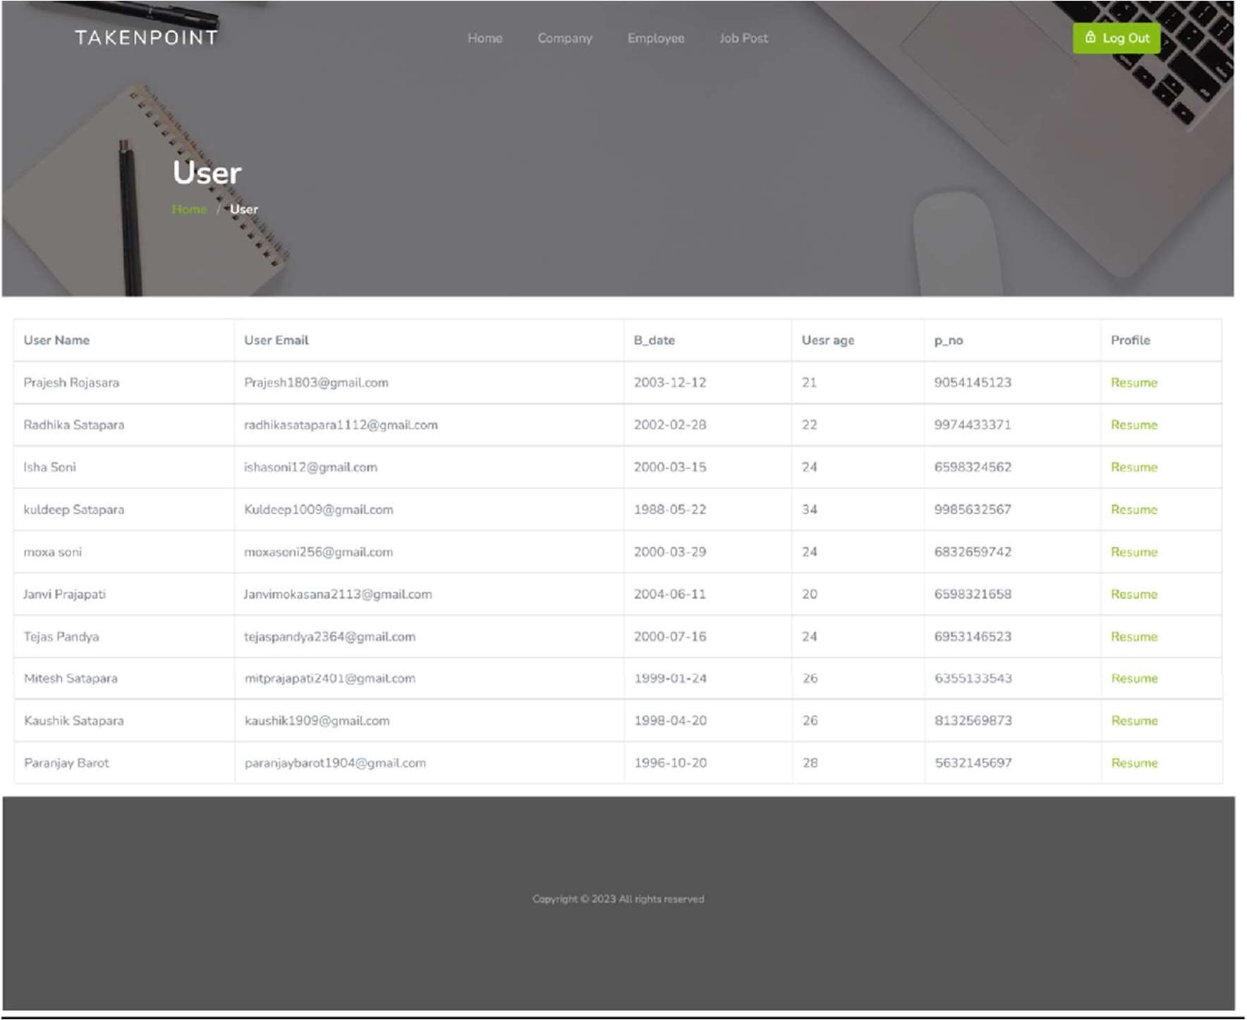
Admin Employee:
This is admin Employee page.
Here you have to add the user name, Email , Birth date, age , phone no along with the user profile.

Slide 27
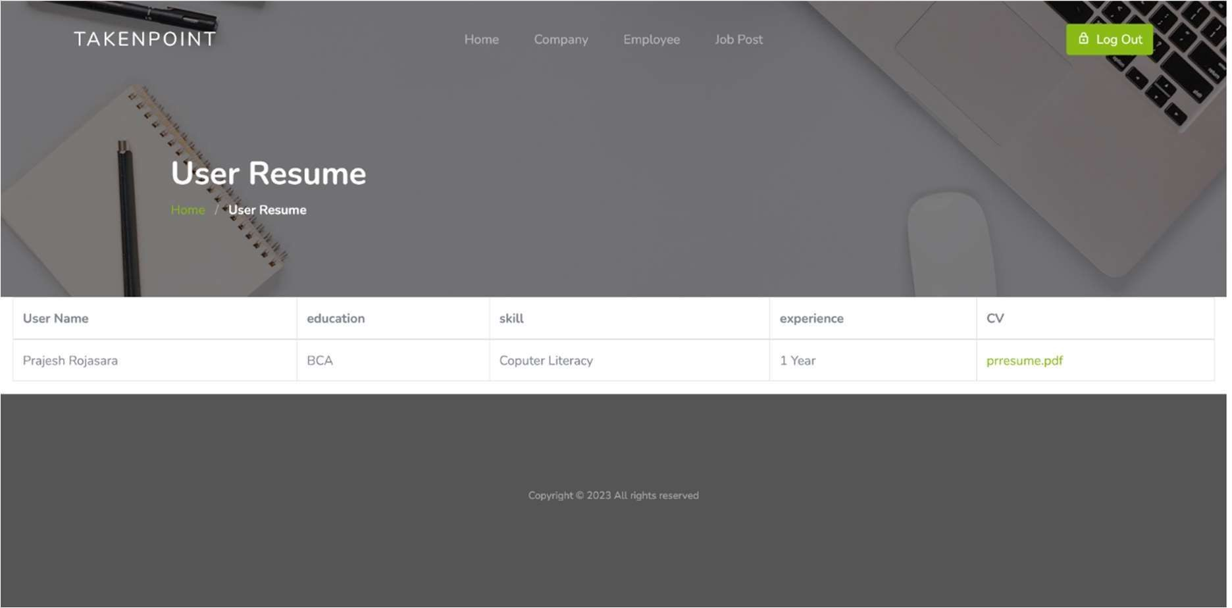
Admin Employee Resume:
This is admin Employee Resume page.
Here User upload his/her Resume along with education , skills and experience.

Slide 28
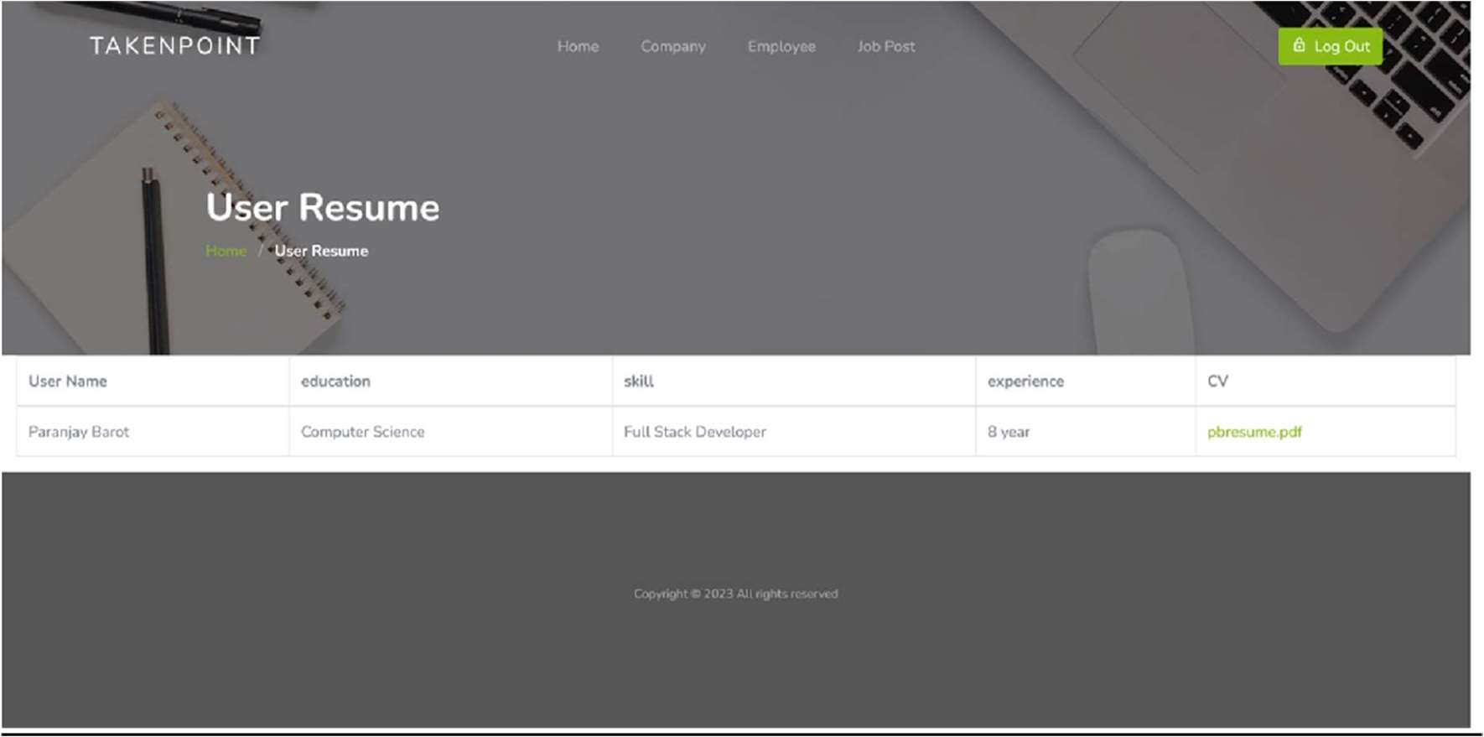
This is User Resume page where User can add his/her profile.

Slide 29
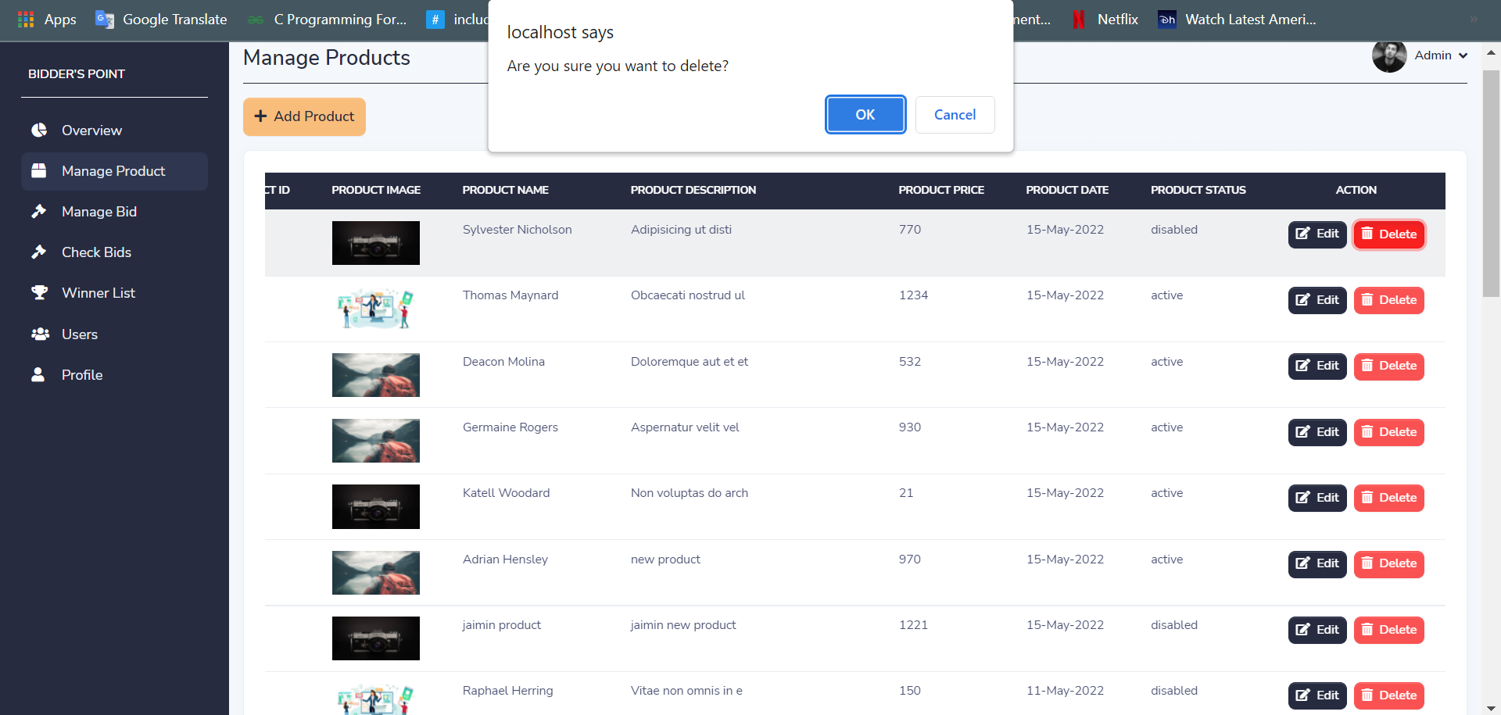
Delete product with confirmation
Description: - It is delete product functionality with confirmation message. Admin can delete product by clicking on "delete" button.

Slide 30
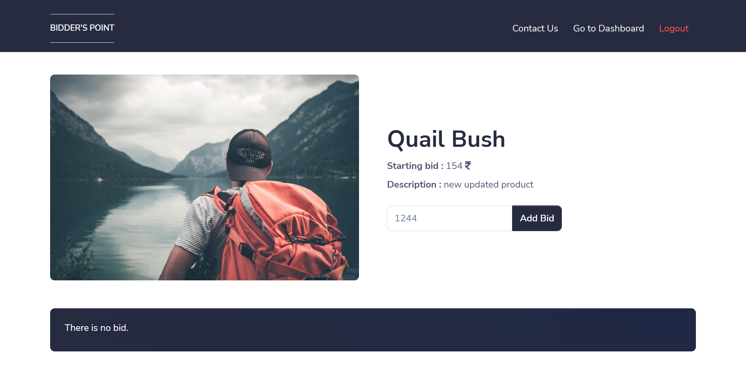
Add bid page
Description: - It is add bid page. Admin can add bid by clicking on “add bid” button on any particular product.

Slide 31
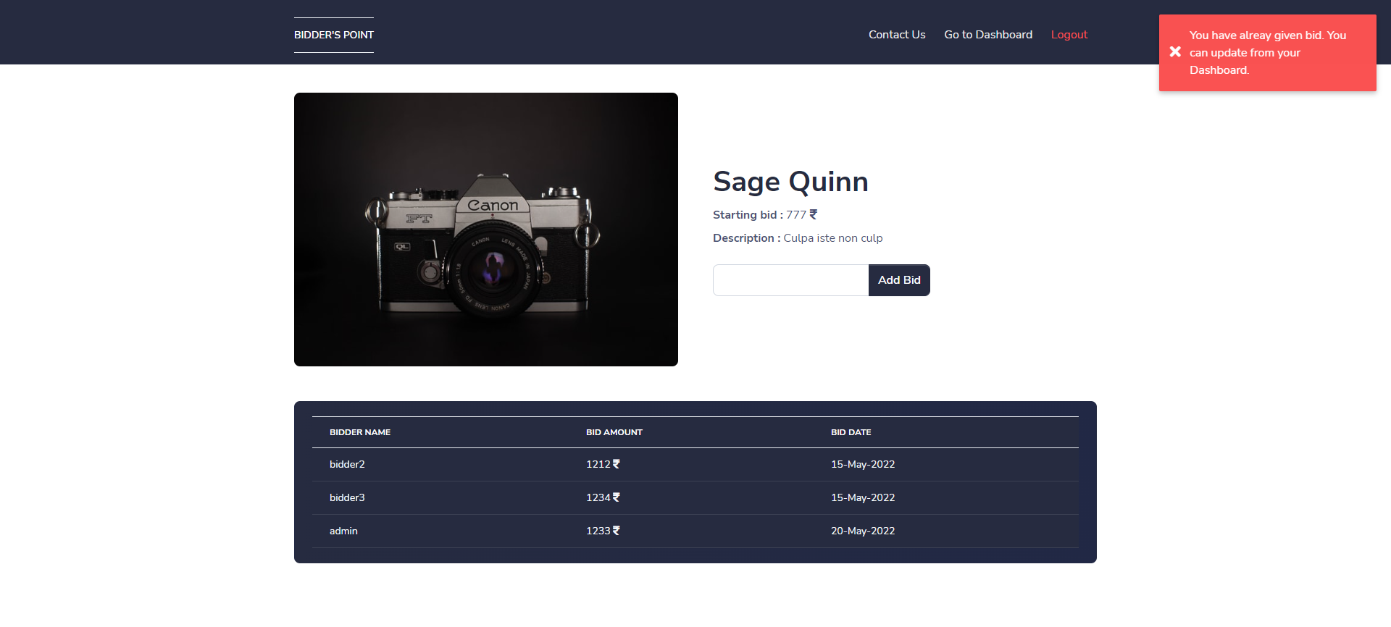
Add bid page with validation
Description: - It is add bid page with validation. If admin has already given bid and we again try to give bid then add bid page will give one error message as popup.

Slide 32
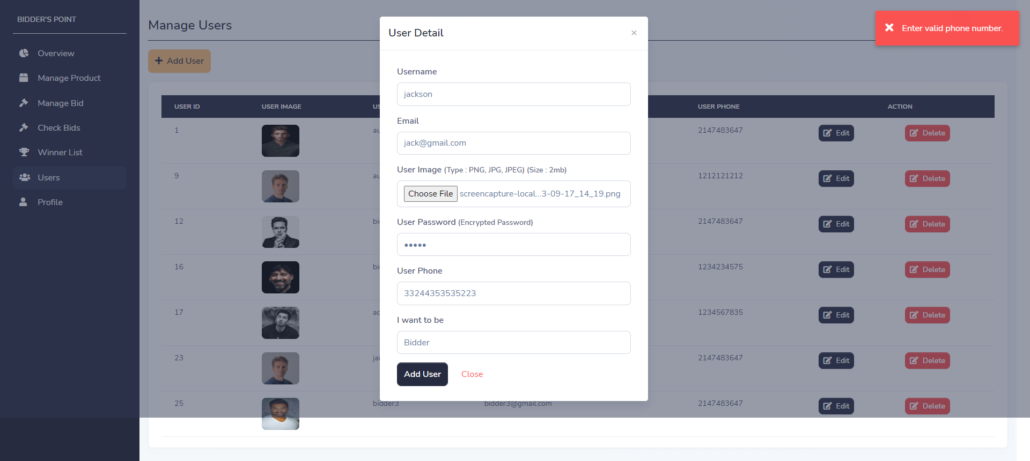
Add user page with validation
Description: - It is add bid page with validation. If mobile number is not equal to 10 digits then add user page will give one error message as popup.

Slide 33
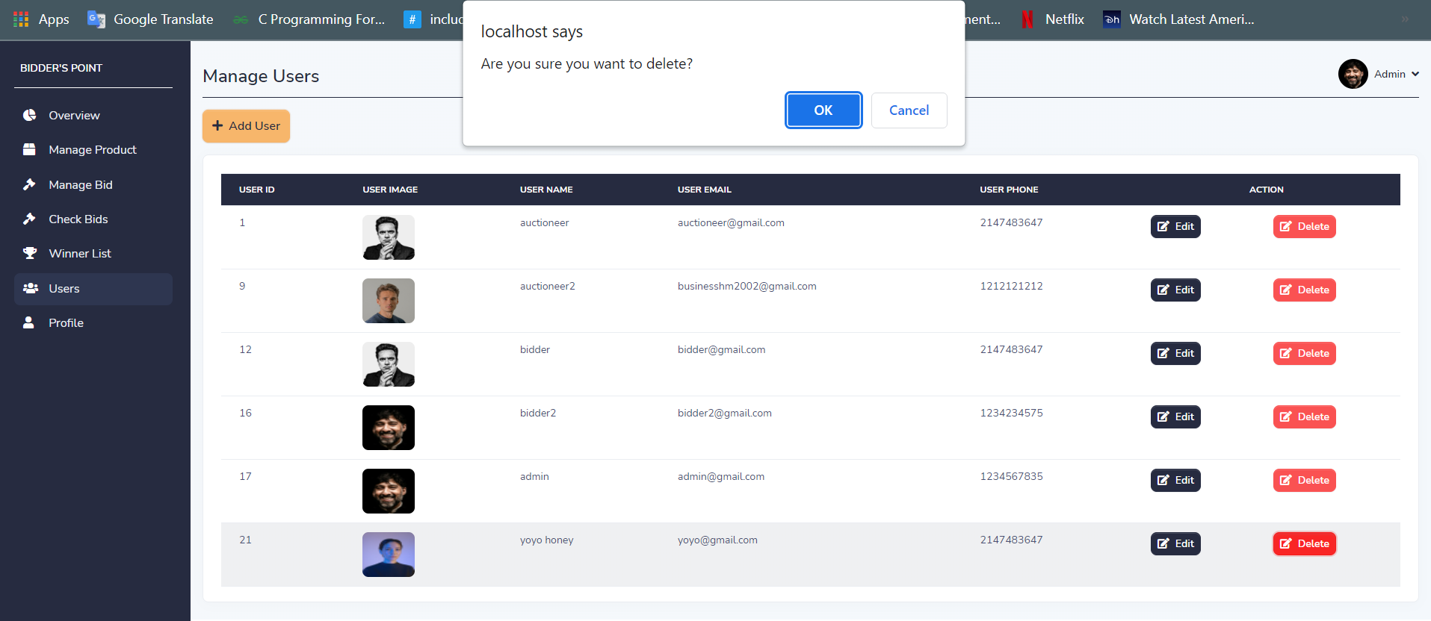
Delete user with confirmation
Description: - It is delete user functionality with confirmation message. Admin can delete any user by clicking on "delete" button.

Slide 34
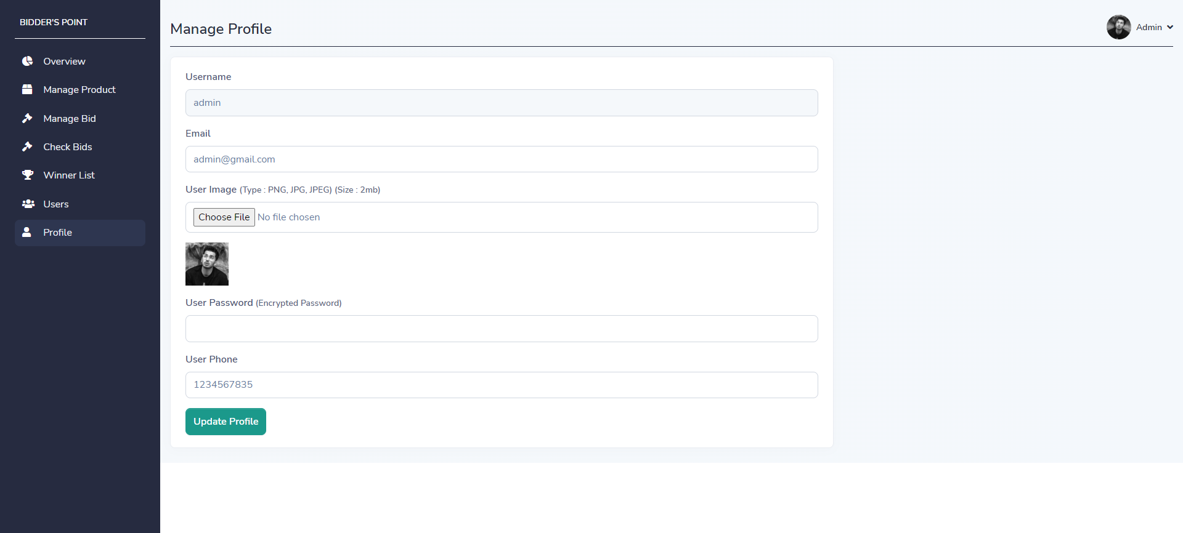
Update profile page
Description: - It is update profile page. Admin can update profile by clicking on “update profile” button.

Slide 35
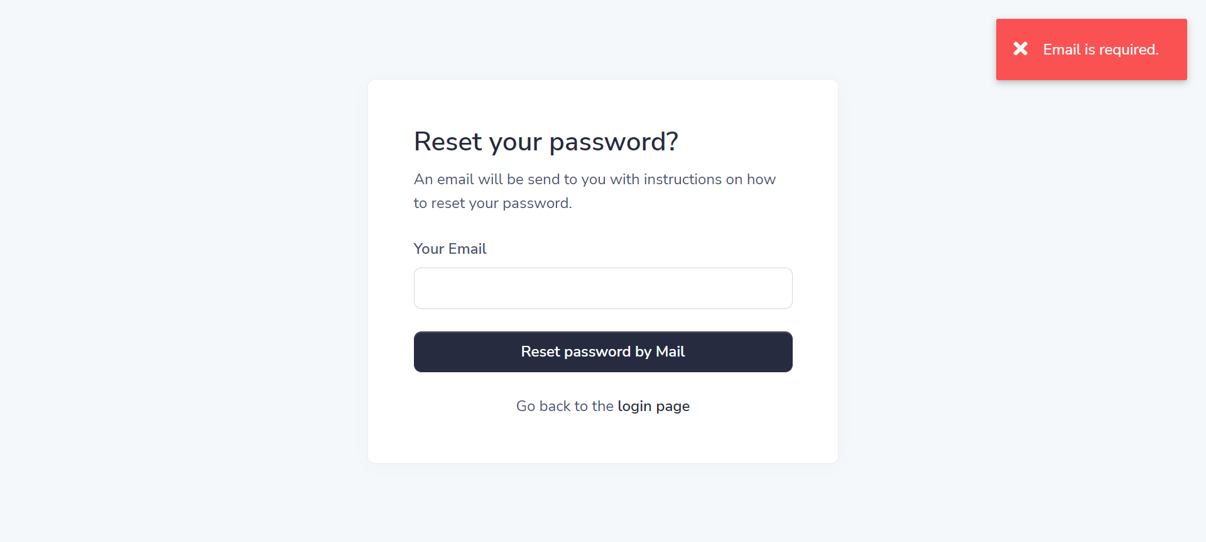
Forget password page with validation
Description: - It is forgot password page with validation. If the entered details are valid then the forgot password form will send reset link to email otherwise not.

Slide 36
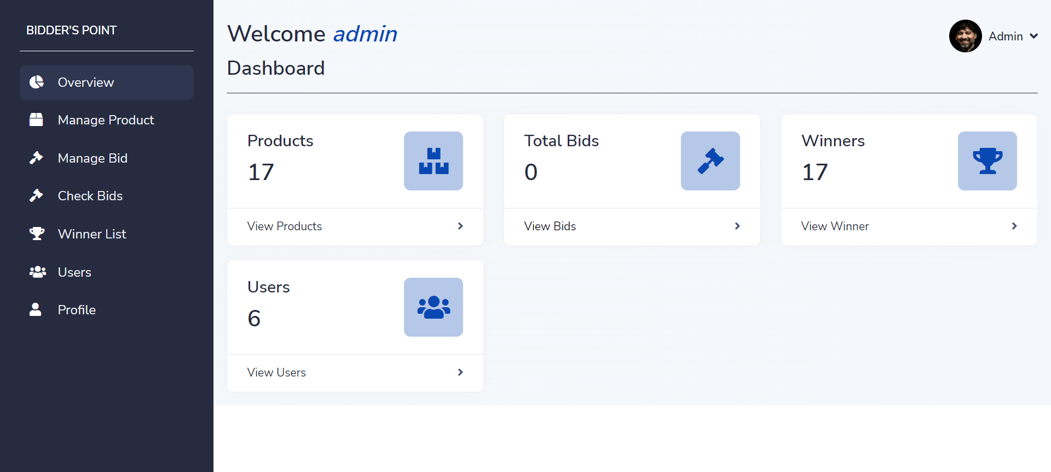
Admin Dashboard
Description: - This is admin dashboard, where admin gets direct link to the particular page and can see product , bid and winners from dashboard.

Slide 37
12. TESTING
No. | Test Condition | Description | Expected Result | Actual Output | Status
1 | Registration | Click on sign up button without Username | System will display validation message | System display message like “All fields are required” | Pass
 |  | Click on sign up button without Email | System will display validation message | System display message like “All fields are required” | Pass
 |  | Click on sign up button with invalid mobile number | System will display validation message | System display message like “Enter valid phone number” | Pass
 |  | Click on sign up button with all valid input data | System will register a new user | System display message like “Registration successful” | Pass

Slide 38
No. | Test Condition | Description | Expected Result | Actual Output | Status
2 | Login | Non-Registered user | System will not allow Non-Registered user to login | System will display validation message like “Can’t find user” | Pass
 |  | Click on login button with invalid email and password | System will not allow user to login | System will display validation message like “Invalid login details” | Pass
 |  | Click on login button with valid email and password | System will allow to login | System will display validation message like “Login successful” | Pass

Slide 39
No. | Test Condition | Description | Expected Result | Actual Output | Status
3. | Forget Password | Click on reset password button without email | System will display validation message | System display message like “Email is required” | Pass
 |  | Click on reset password button with wrong email | System will display validation message | System display message like “Email doesn't exist!” | Pass
 |  | Click on reset password button with valid email | System will allow to send reset link to email | System display message like “Reset password link send to email” | Pass

Slide 40
No. | Test Condition | Description | Expected Result | Actual Output | Status
4. | Add Bid | Click on add bid button without bid amount and user is logged in as bidder. | System will display validation message | System display message like “Please enter your bid amount” | Pass
 |  | Click on add bid button without / with bid amount and user is not logged in as bidder | System will display validation message | System display message like “You have to be logged in as bidder to add bid” | Pass
 |  | Click on add bid button with bid amount and user is logged in as bidder | System will allow to add bid | System display message like “Bid added successfully” | Pass

Slide 41
No. | Test Condition | Description | Expected Result | Actual Output | Status
5. | Update Profile | Click on update button without email | System will display validation message | System display message like “All fields are required” | Pass
 |  | Click on update button without phone number | System will display validation message | System display message like “All fields are required” | Pass
 |  | Click on update button with invalid phone number | System will display validation message | System display message like “Enter valid phone number” | Pass
 |  | Click on update button with valid input data | System will allow to update profile | System display message like “User updated successfully” | Pass

Slide 42
13. FUTURE ENHANCEMENT
I will provide google authentication facility, so user can sign up through google account.
Notification system like how many auctioneer and bidder are active on website.
In future, I will provide the SMS and Email facility.
I will make SEO Friendly website.
I will provide ultimate and premium account facility so auctioneer and bidder will get more advantage.

Slide 43
14. BIBLIOGRAPHY
For developing this “ BIDDER’s POINT ” I have referred the following website:
  CSS framework (Bootstrap)
    https://getbootstrap.com/
  Website template with dashboard design
    https://themesberg.com/product/admin-dashboard/volt-bootstrap-5-dashboard
  Icons
    https://fontawesome.com/

Slide 44
THANK YOU

